Slide 1
BBIFMAC – Overview of Water Quality Monitoring Activities in the Lower Burdekin

Slide 2
BBIFMAC’s role -Independent, local organisation with a long history and expertise water quality monitoring in the local area. -Conducted from catchment sub-catchment paddock scale. -Water quality monitoring is used to validate the impact of different farm practices. This is useful as a decision support tool for growers. -For some sites the water quality data may be used to inform reporting or improve modelling specific to the Burdekin. -Water quality monitoring is not just about DIN and pesticides, but also about measuring runoff volumes.

Slide 3
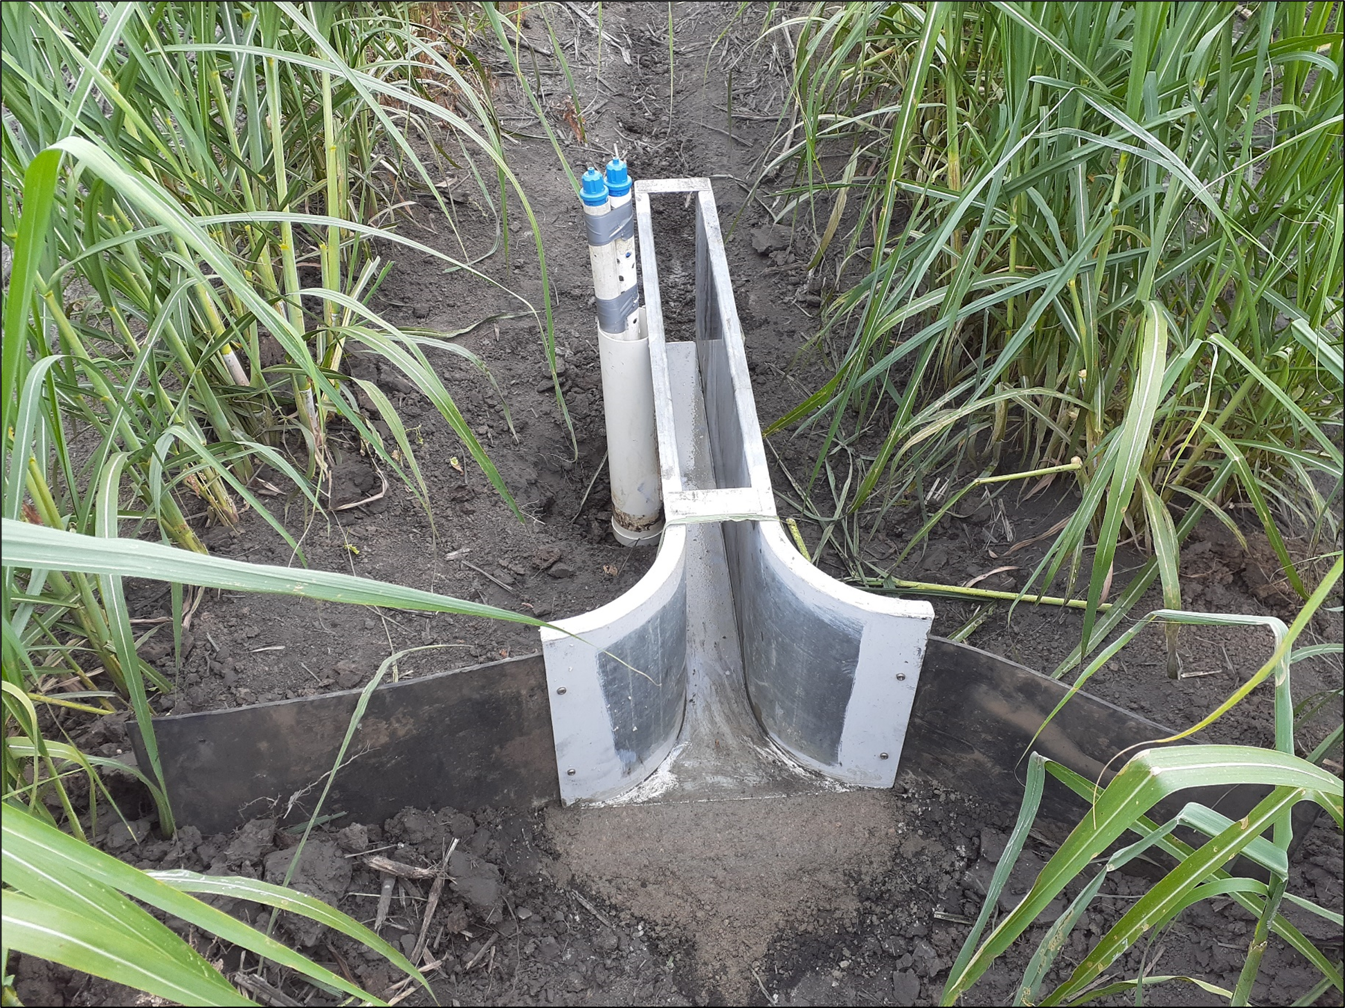
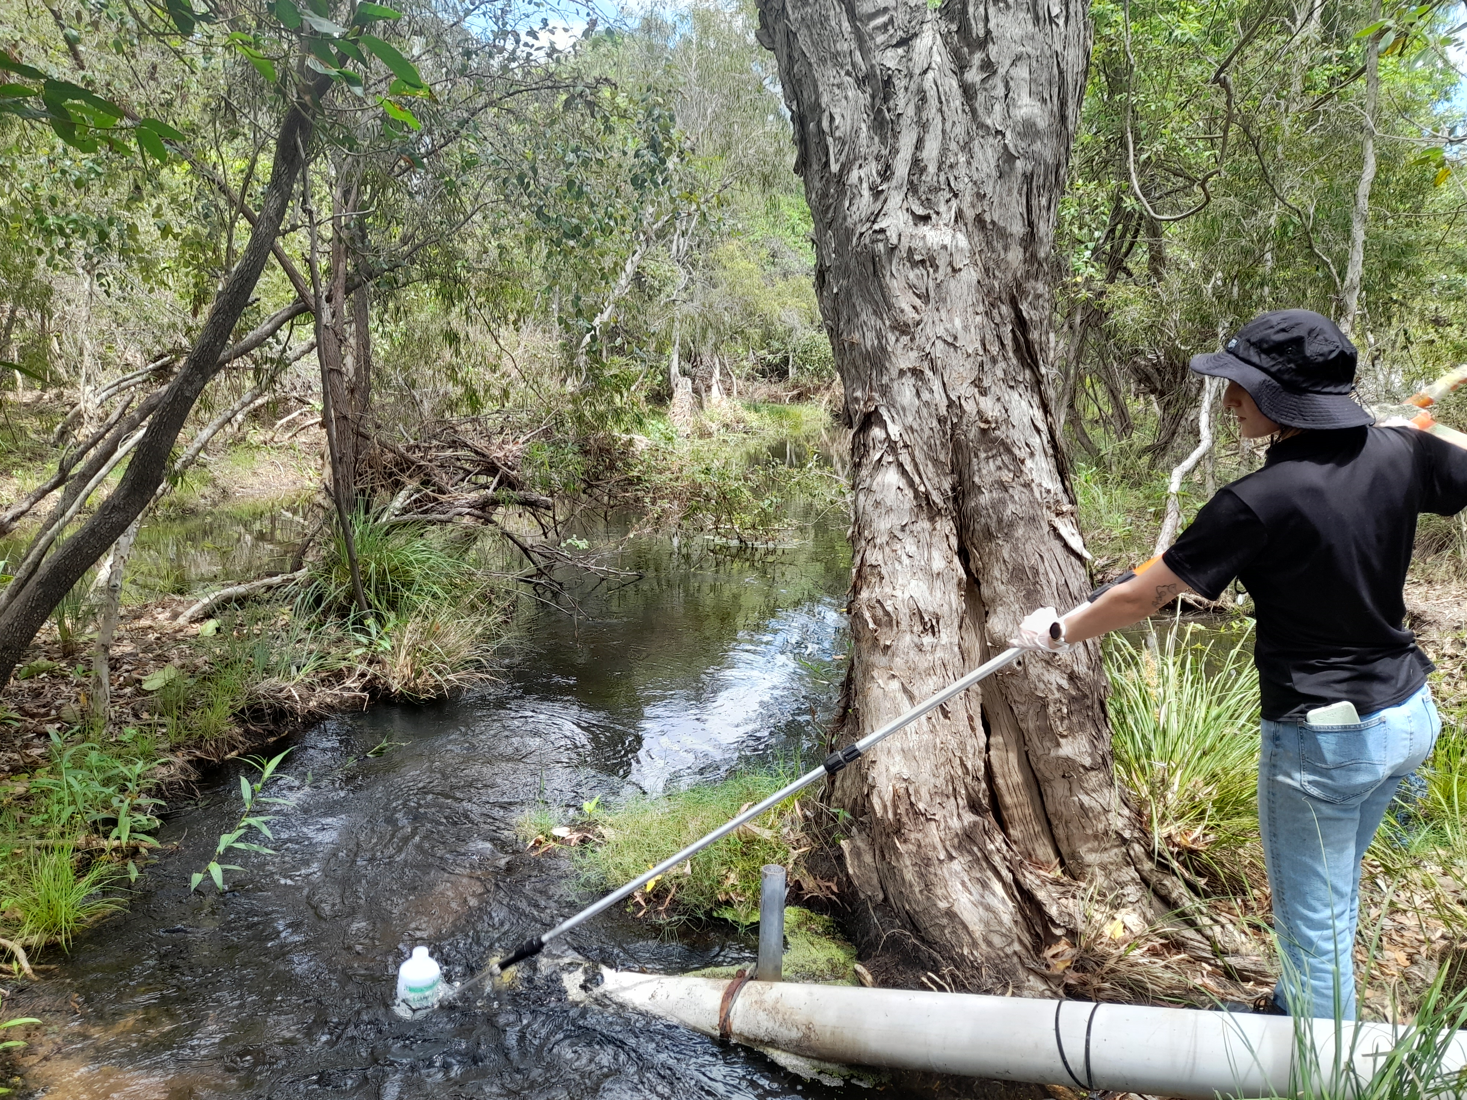
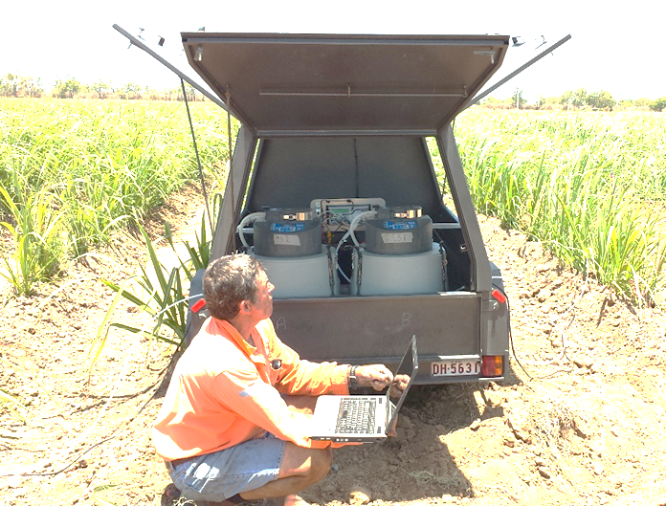
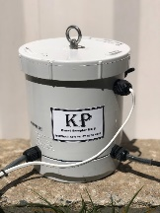
Sampling equipment
San dimas flumes and height loggers
Real time water quality sensors
Grab pole
Auto-samplers

Slide 4
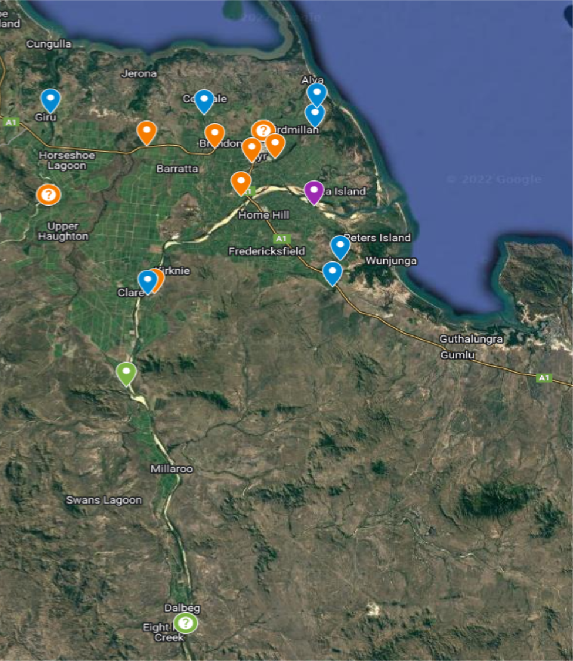
Catchment scale monitoring -Monitoring more than 20 different sites across the lower Burdekin to better understand the water quality of each catchment over time and how it responds to external influences (weather, land-use). - Combination of grab samples, auto-samples and in-situ, real time probes/sensors.

Slide 5
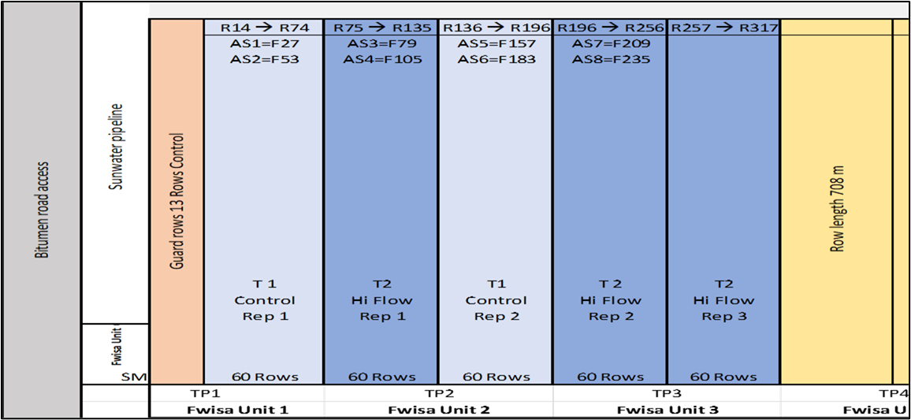
Paddock scale monitoring -Measure the baseline (grower standard practice) vs changed practice. -Same paddock, same crop stage, several seasons, multiple monitoring points (replicates) in each ‘treatment’ to reduce data ‘noise’.

Slide 6
What is the common factor? -Water is the driving force, of on-farm losses to the downstream environment. -It is not just about the reef, at the farm level there are significant economic impacts at stake. -With rising input costs, increasingly unpredictable weather, and volatile agricultural markets, minimising on-farm losses is more important than ever. -Understanding and minimising potential loss mechanisms is essential to improving farm performance into the future. -This is why every drop counts.

Slide 7
What is produced for the BIP? -A hydrograph for each irrigation event showing when irrigation run-off reached end of paddock, and how long it ran off for. -From this a total volume of run-off can be calculated. -When considered with total volume of irrigation applied, a proportion of irrigation lost to run-off can be derived. -Can plot when irrigation was stopped and see how long run-off continued. -In many cases run-off continues for several hours after irrigation shut-off.

Slide 8
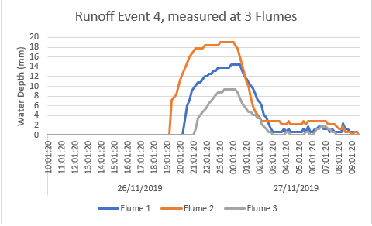
Irrigation run-off hydrograph- example
Irrigation duration
Runoff duration
Irrigation start
Irrigation stop

Slide 9
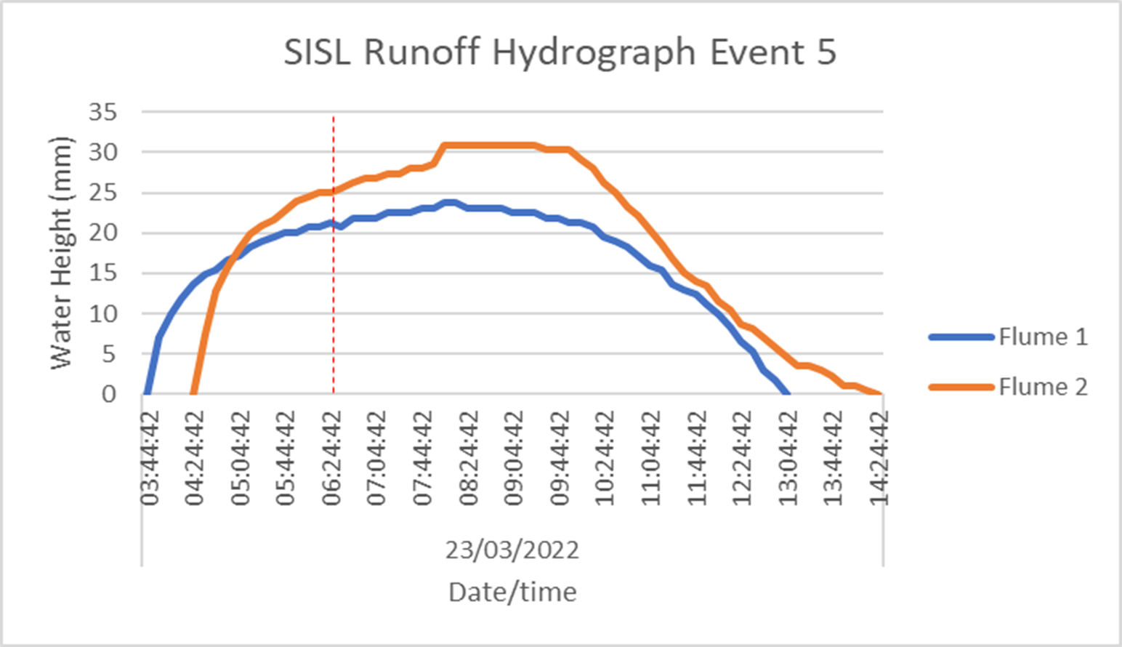
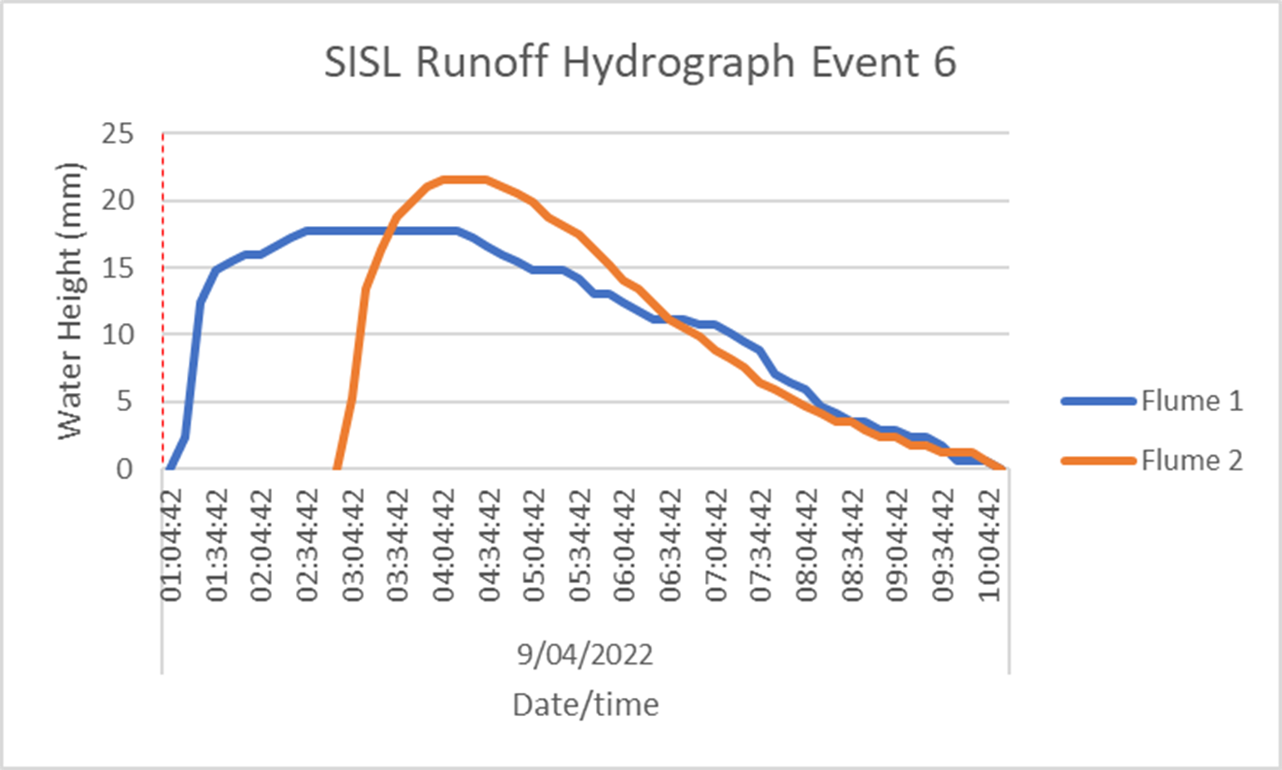
SITE 1: BRIA example-transition to automation
Water turned off at this time

Slide 10
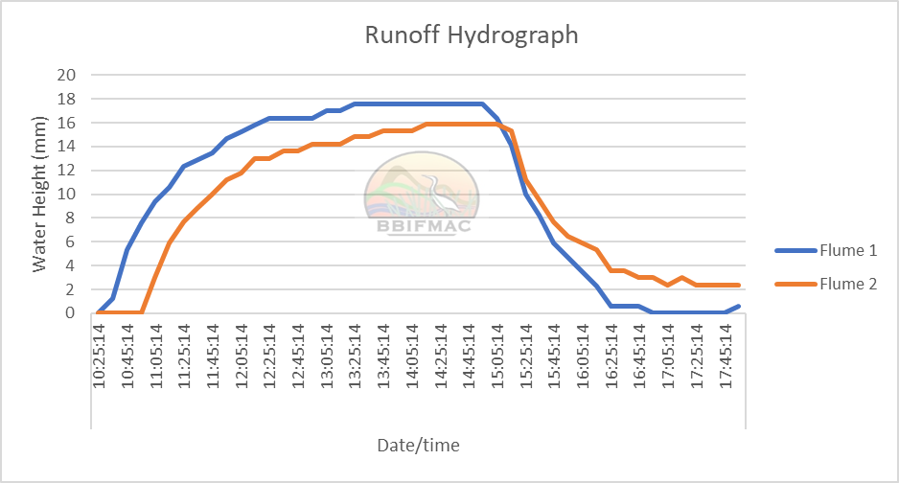
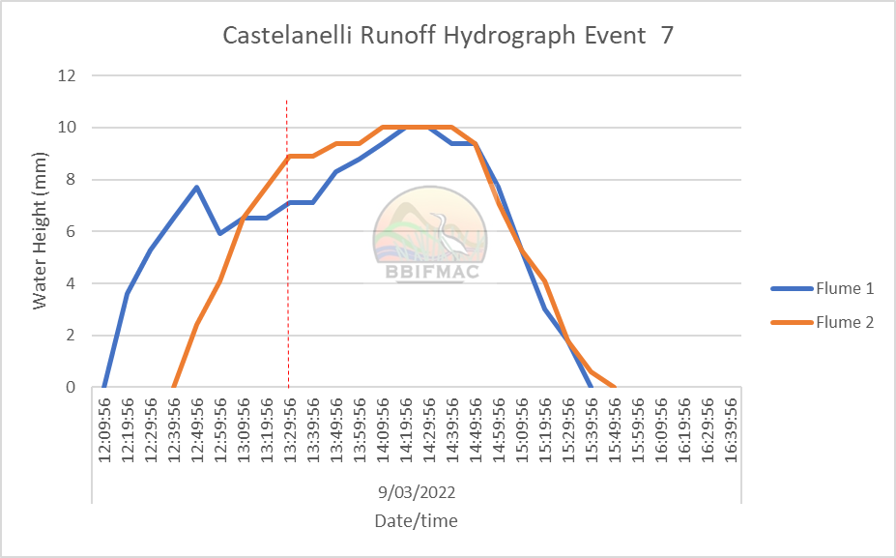
Site 2: Delta example – manual irrigation
Water turned off at this time
Irrigation Method + Irrigation Time | Total Runoff Duration | Shut off timing* | Proportion lost to runoff
Standard practice (manual control, 8hr) | 7.5 hours | 3.5 hours after Flume 1, 3 hours after Flume 2 | 18%
Improved practice (manual control, 5hr) | 3.5 hours | 1.5 hours after Flume 1, 1 hours after Flume 2 | 8%

Slide 11
WQ monitoring assists farmers by: Providing current, locally relevant, robust data to support growers Improve productivity: -reduced growth impacts from over-watering or under-watering, -reduced fertiliser and chemical losses in runoff, de-nitrification , -reduced input costs (water, power, labour, fertiliser, chemical) Reduce downstream environmental impacts: -reduced surface runoff volumes and deep drainage, -reduced nutrient and chemical loads. Improve public perception of farm management: -less surface runoff coming off paddocks visible to general public

